Slide 1

Java CA
SA 49 – Team 1
Aye Moe Phyu (e0457825)
Kaung Khant Kyaw (e0457836)
Ngik Guo Ming (e0457839)
Suwetaa Ramesh (e0457811)
Tang Qianwenjing (e0457780)
Wang Xuezhi (e0457838)

Slide 2
Work Distribution
Database & UI Design
Additional Features
Aye Moe Phyu
Kaung Khant Kyaw
Ngik Guo Ming
Suwetaa Ramesh
Tang Qianwenjing
Wang Xuezhi
Aye Moe Phyu
Ngik Guo Ming
Coding
Review & Merge
Student: Aye Moe Phyu, Suwetaa Ramesh
Faculty: Ngik Guo Ming, Tang Qianwenjing
Admin: Wang Xuezhi, Kaung Khant Kyaw
Wang Xuezhi

Slide 3
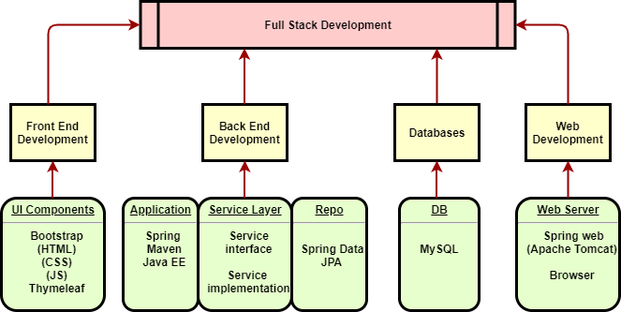
Architecture/Layer Description

Slide 4
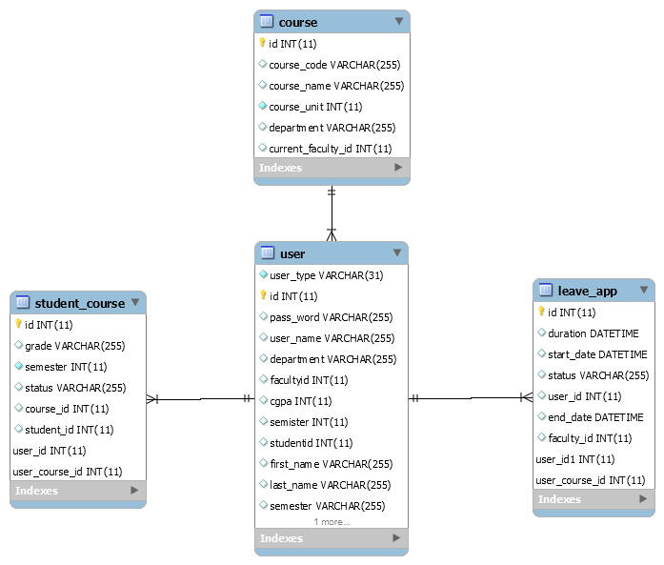




Class Diagram/ERD

Slide 5
Technologies Used
Bootstrap (HTML, CSS, JS)
Spring Framework Abstraction (Data & MVC)
ThymeLeaf
Spring Data JPA
MySQL Database System
Security
Maven
Data Scripts
Repositories & Services Layer
Java EE

Slide 6
Lessons Learnt
Data Structure Design
Problem Solving
Teamwork
Integrate code on Github

Slide 7
THANK YOU

